Slide 1
VR-Game
Anna Wenger

Slide 2
Task
Create a VR Game
There has to be:
a room
a globe which is rotating
a riddle to solve
interact with objects
locomotion

Slide 3
Idea
Power
Tree

Slide 4
Idea
A room with a big tree and a locked door
“Welcome to the world“
Keys don‘t work
Only spinning the globe opens the door

Slide 5
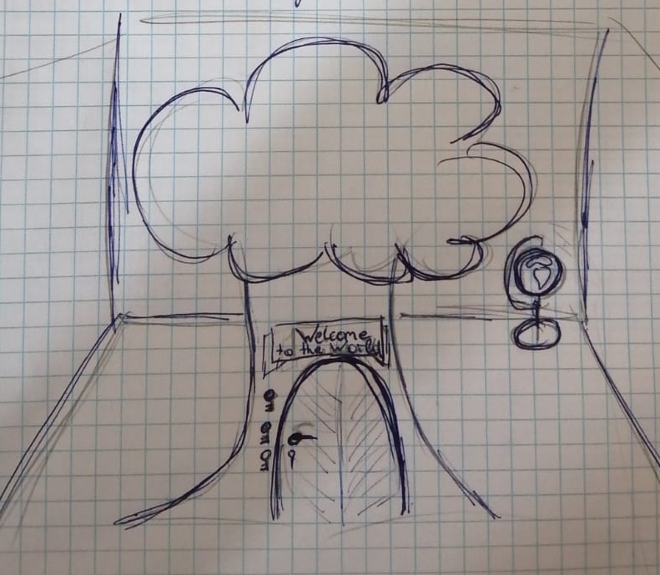
Sketches

Slide 6
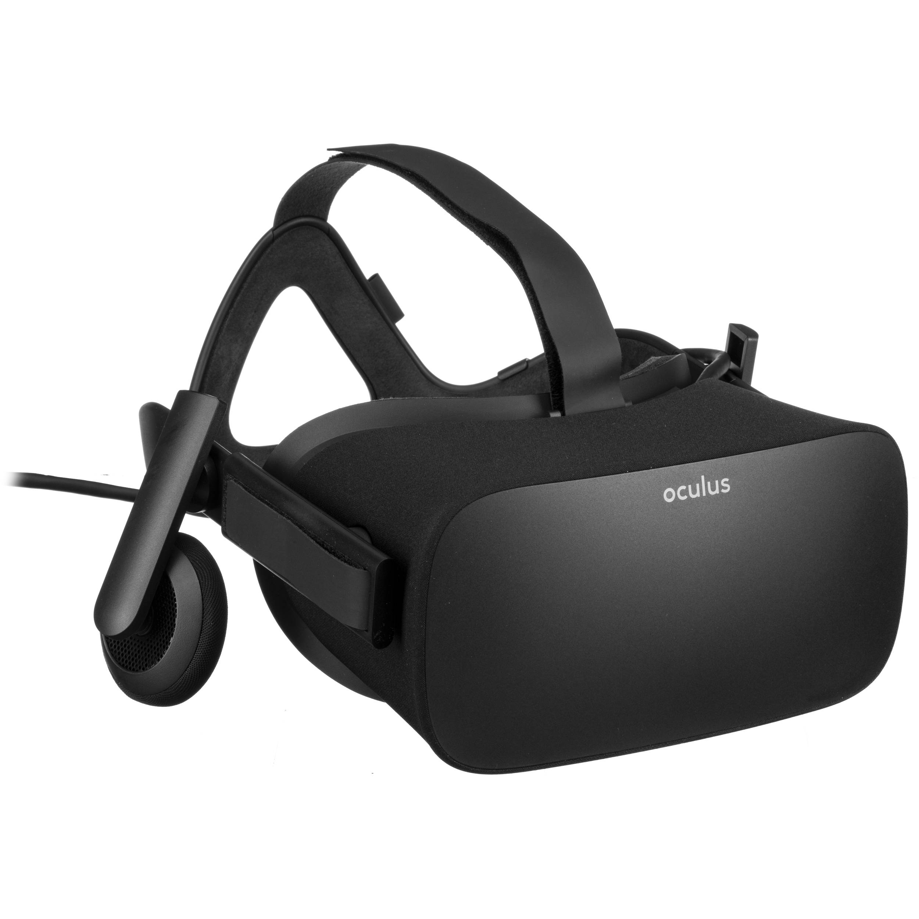
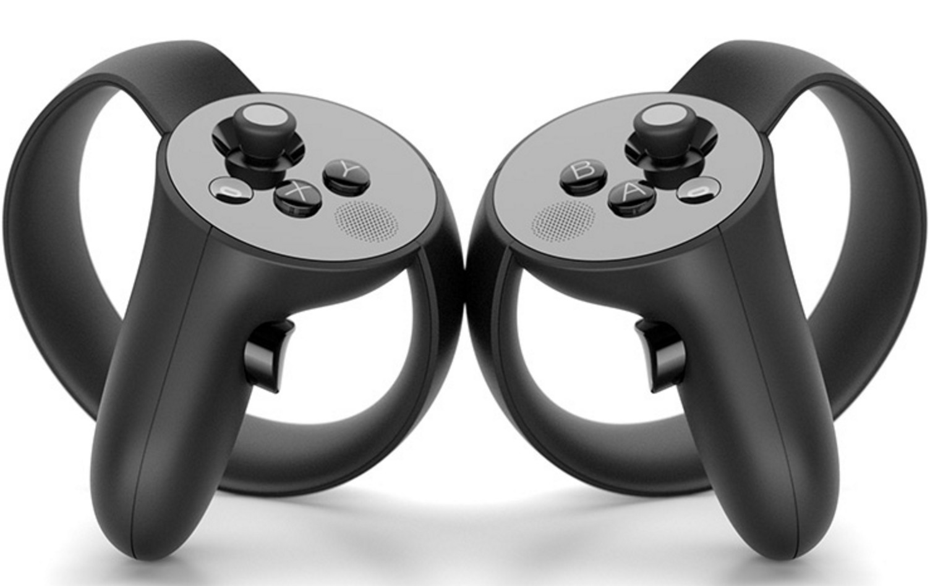
Target Plattform
Oculus Rift

Slide 7
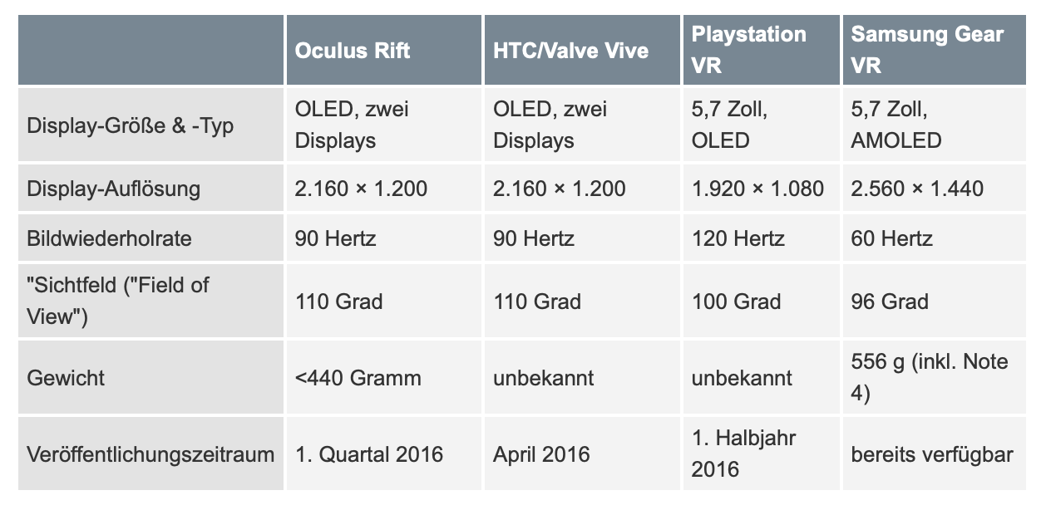
Specifications

Slide 8
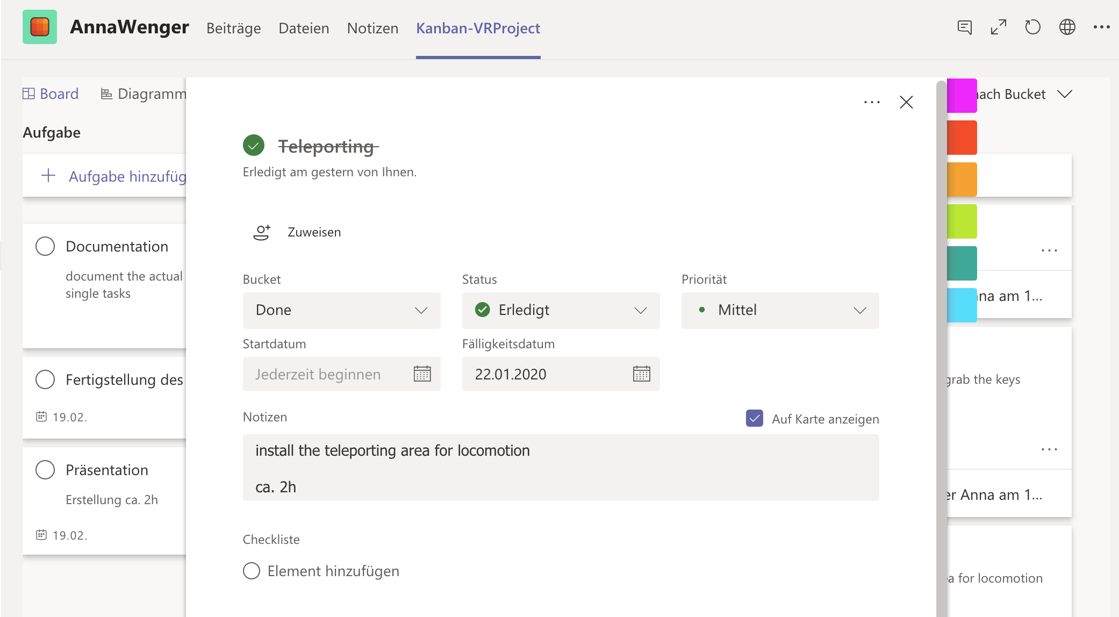
Organisation
Splitted the project in small tasks
Used a Kanbanboard for time management and organisation
Wrote myself notes about the single tasks

Slide 9
Work
Started with white boxing
Installing SteamVR Plugin
Tested the SampleScene
Imported Teleporting-Area
Replaced the whiteboxes with 3D models
Added spinning script to globe
Aded throwable script to the keys
Mostly fixed some problems

Slide 10
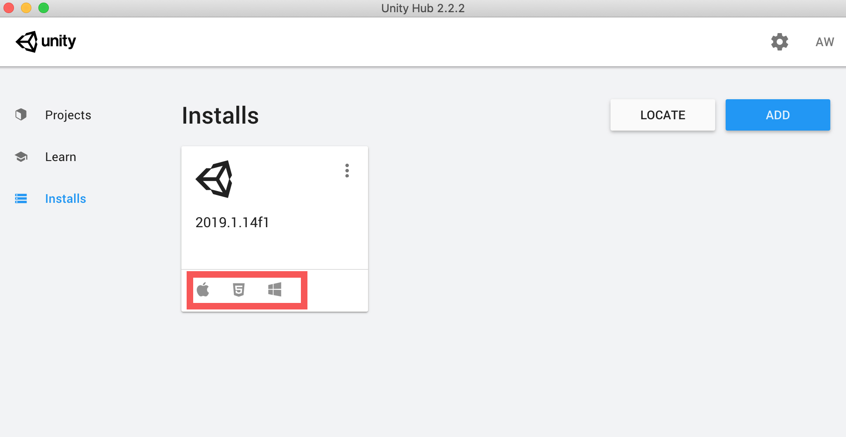
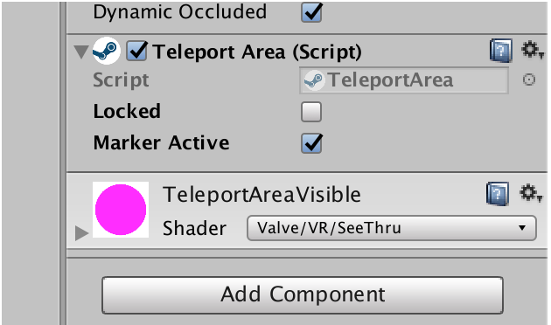
VR Setup
imported SteamVR Plugin
Missing build for windows
Install unity new
Teleporting Area was pink
Had to import the SteamVR Plugin several times

Slide 11
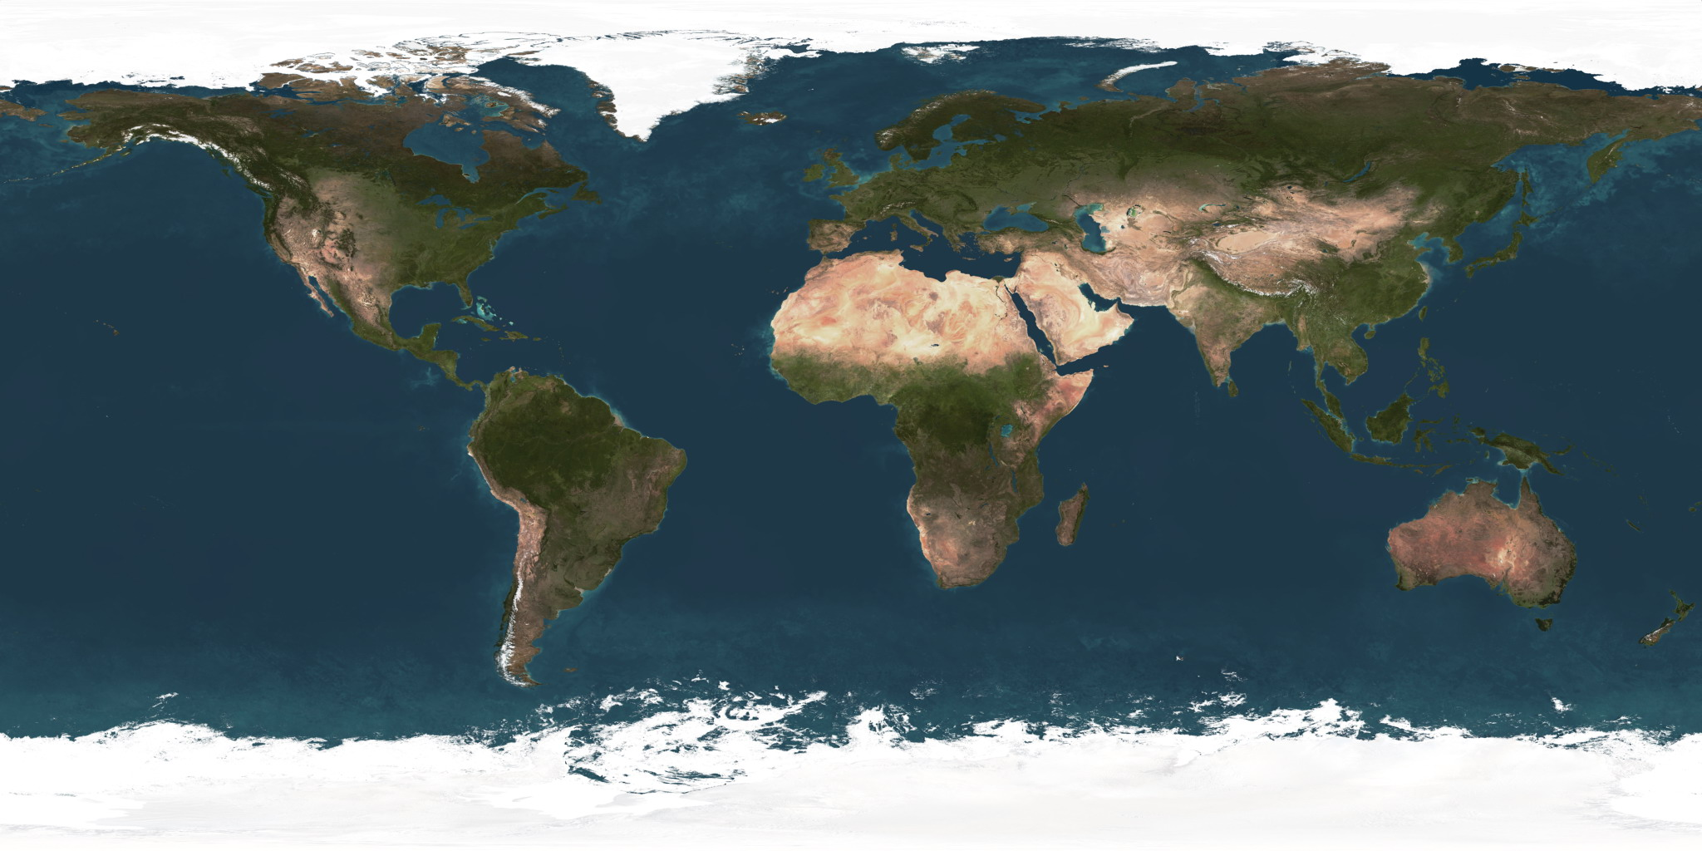
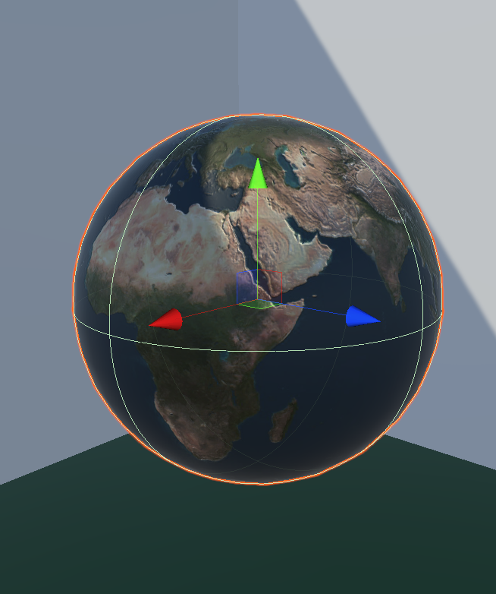
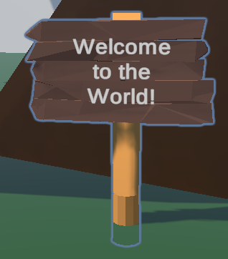
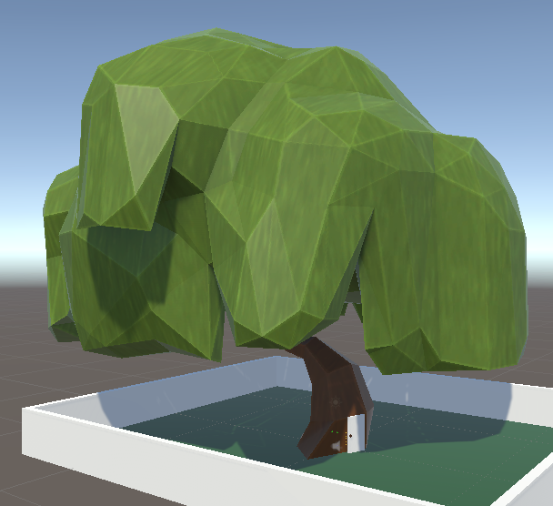
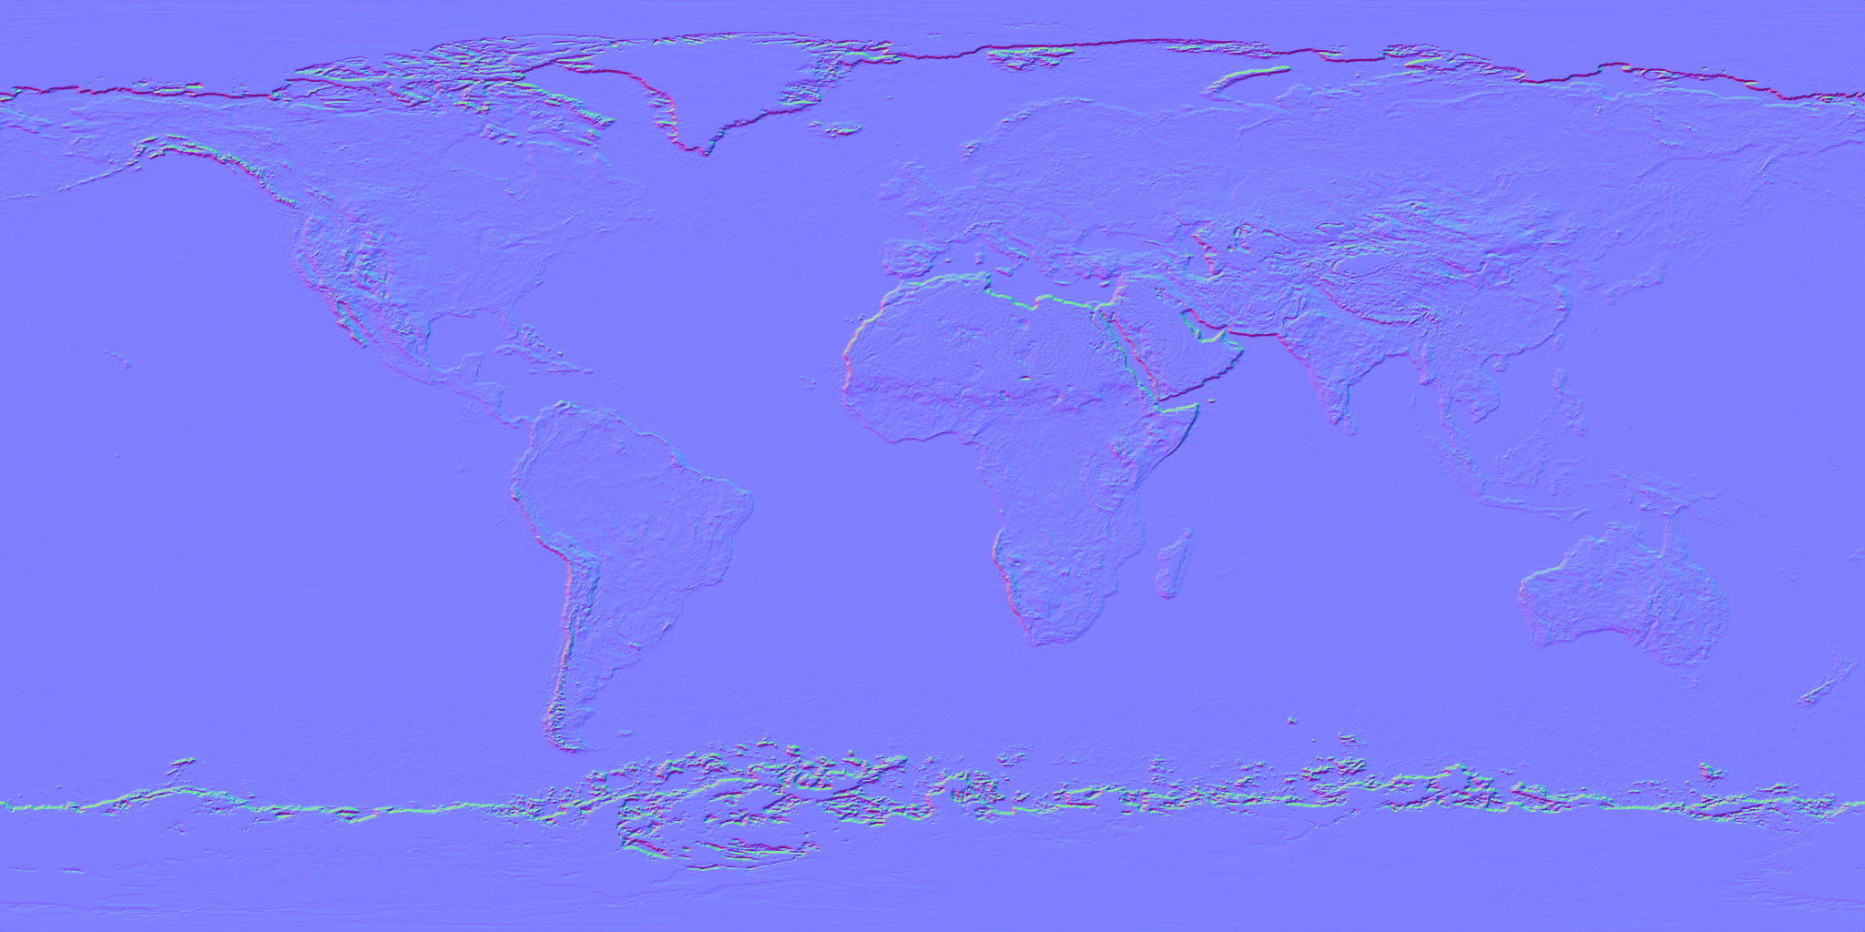
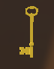
3D Models
Used mainly Google Poly

Slide 12
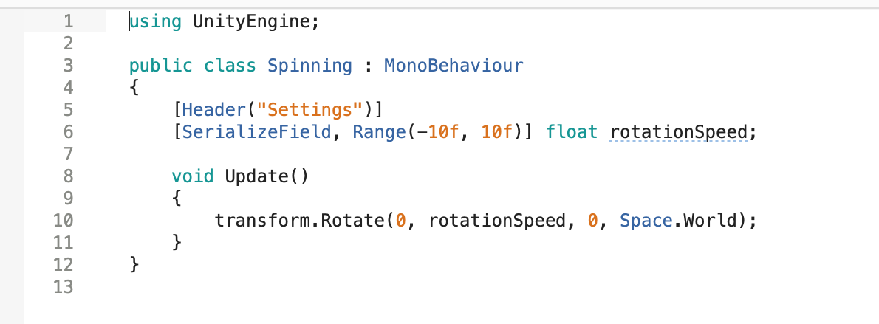
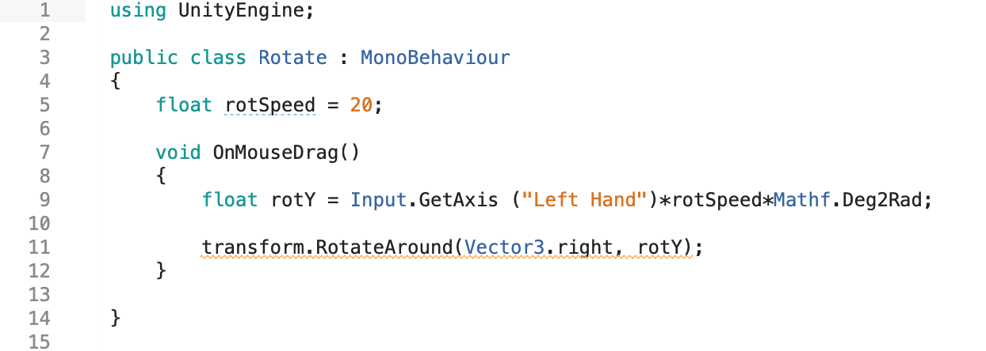
Scripts
Inspired by Valerian
For the spinning of the globe
Didn’t work
For the interaction with the globe

Slide 13
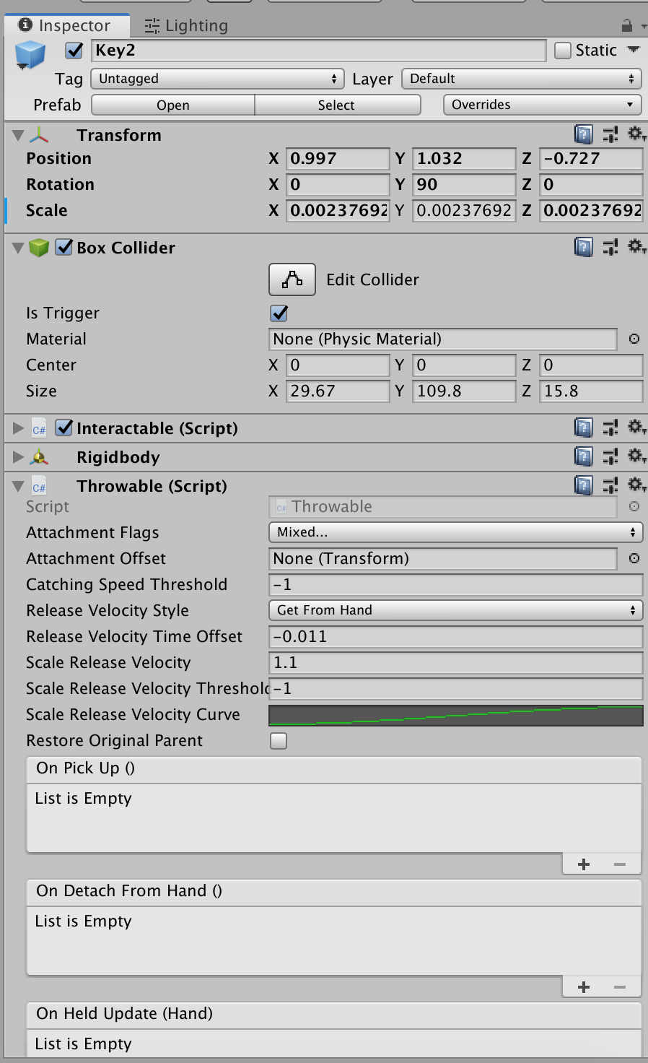
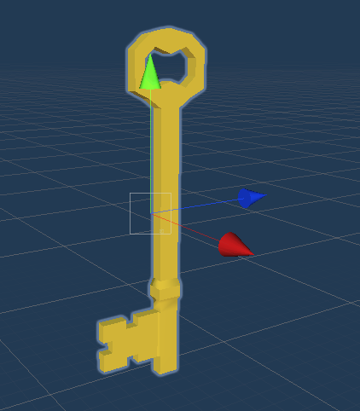
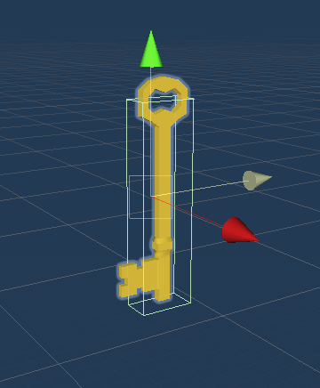
Throwable seemed to not work
Collider was to small to grab the keys

Slide 14
Problems
pushing and pulling
conflicts with different versions of my game
Unconcentrated working
Small and stupid mistakes

Slide 15
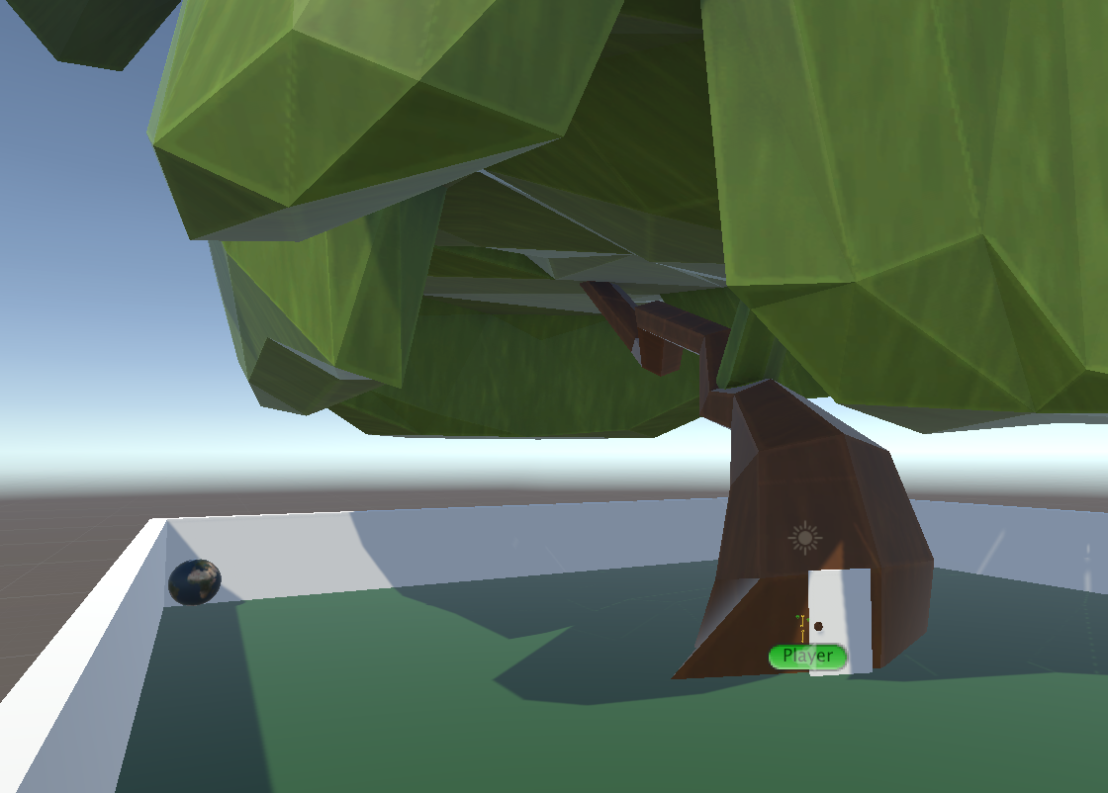
Conclusion
Better time management
More concentration
Keep calm if there is a problem

Slide 16
Thanks for your Attention!

